Slide 1
Fake News Detection
Ankitha Sudarshan
Chaitanya Deepthi Chadalavada

Slide 2
Problem Statement
To identify fake news amongst social media data to help us make informed decisions based on accurate information.
To make a comparative study of three models namely - CNN model, BERT and an ensemble model and evaluate them on this classification task.

Slide 3
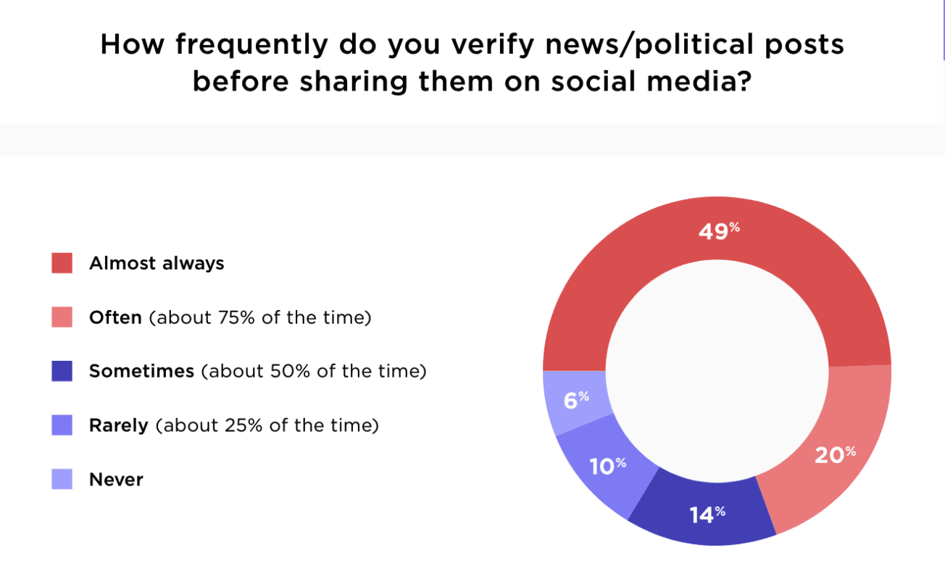
Motivation
Fake news is a major concern due to the ease of sharing information on social media and lack of gate-keeping in the digital age.
Misinformation can have serious consequences, including misinformed public opinions and political manipulation.
Social media platforms are used by 75% of Americans daily, if false information is spread on social media it can exacerbate the situation by reinforcing previous information sources to the users each time.
Promoting fact-based journalism can help prevent the spread of misinformation.

Slide 4
Dataset
Source - Kaggle (https://www.kaggle.com/c/fake-news/data)
Size - 21k
real news - 10413 articles (0)
fake news - 10387 articles (1)

Slide 5
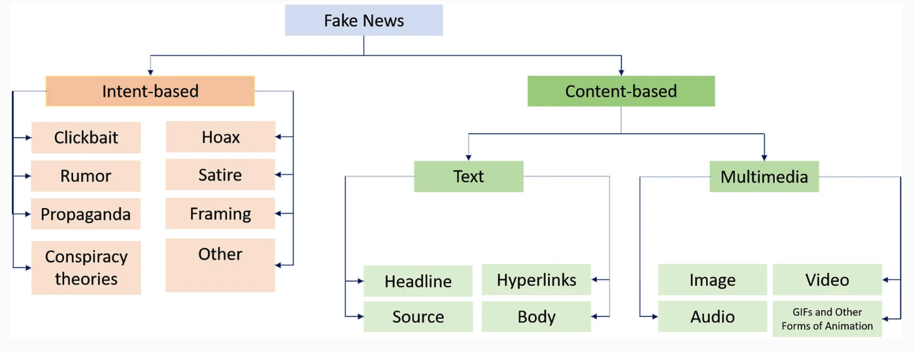
Types of Fake News
Audio Visual Fake News - Deepfakes
Text Based Fake News - Social media articles
In this experiment, we focussed mainly on Content-based fake news identification using Text from dataset.

Slide 6
Methodology
We employed three methods to approach the problem statement namely -
Custom CNN model with GloVe embeddings
BERT model fine tuned on fake news data
An ensemble model

Slide 7
CNN model
This is a custom CNN model with 8 layers - 6 convolutional layers and 2 dense layers. Dropouts are included in the model.
GloVe embeddings of dimension 100 are used.
Input sequence length = 1000
Trained and evaluated on 3 and 5 epochs with a batch size of 128
A total of 400,000 word vectors are in GloVe - The GloVe model has learned to represent the meaning of each word in a high-dimensional vector space.
This model gave an accuracy of 63% for 3 epochs and 65% for 5 epochs. We used wandb to check the progress of training progress and hyperparameters.
However from the analysis, the model overfit the data for 5 epochs on test data and for 3 epochs it was working smoothly.

Slide 8
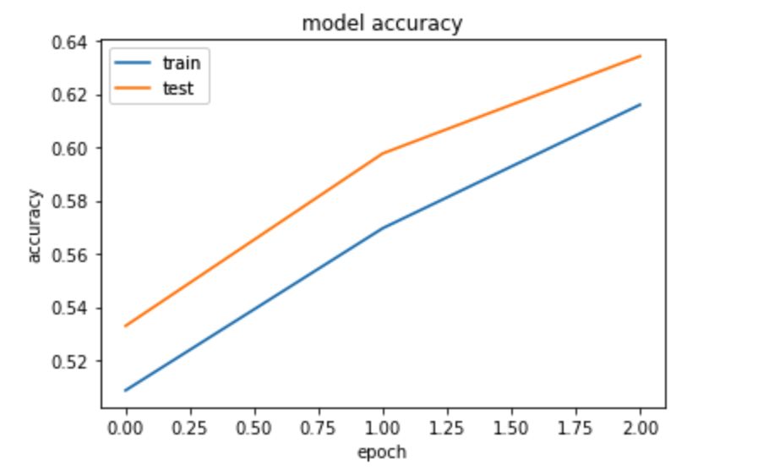
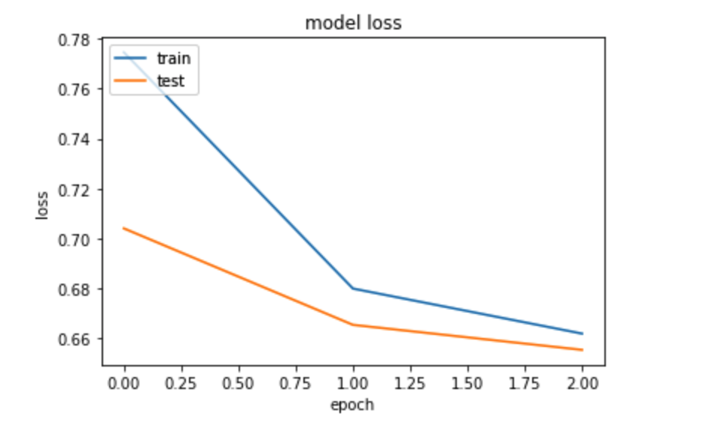
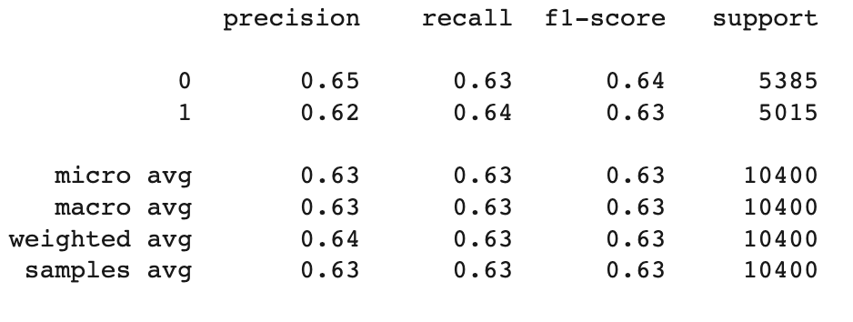
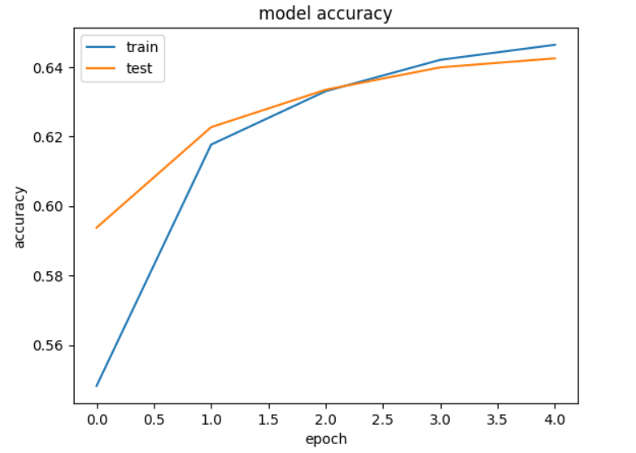
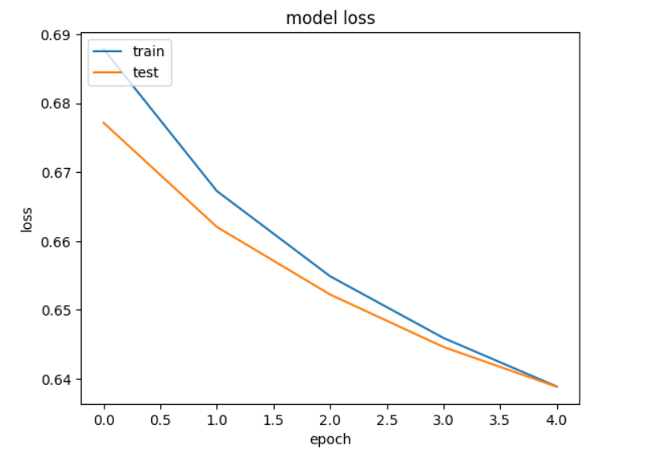
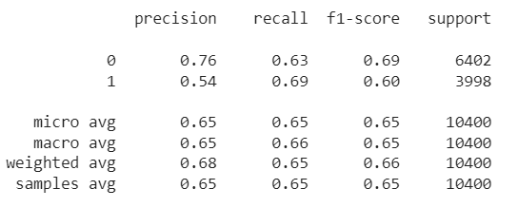
Results Analysis (CNN Model)
Model Accuracy and Loss on 3 Epochs
Model Accuracy and Loss on 5 Epochs

Slide 9
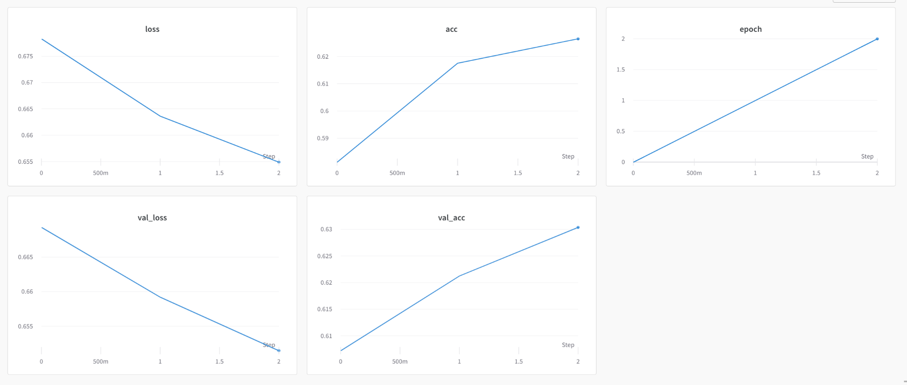
Wandb Results Summary of CNN Model (3 Epochs)

Slide 10
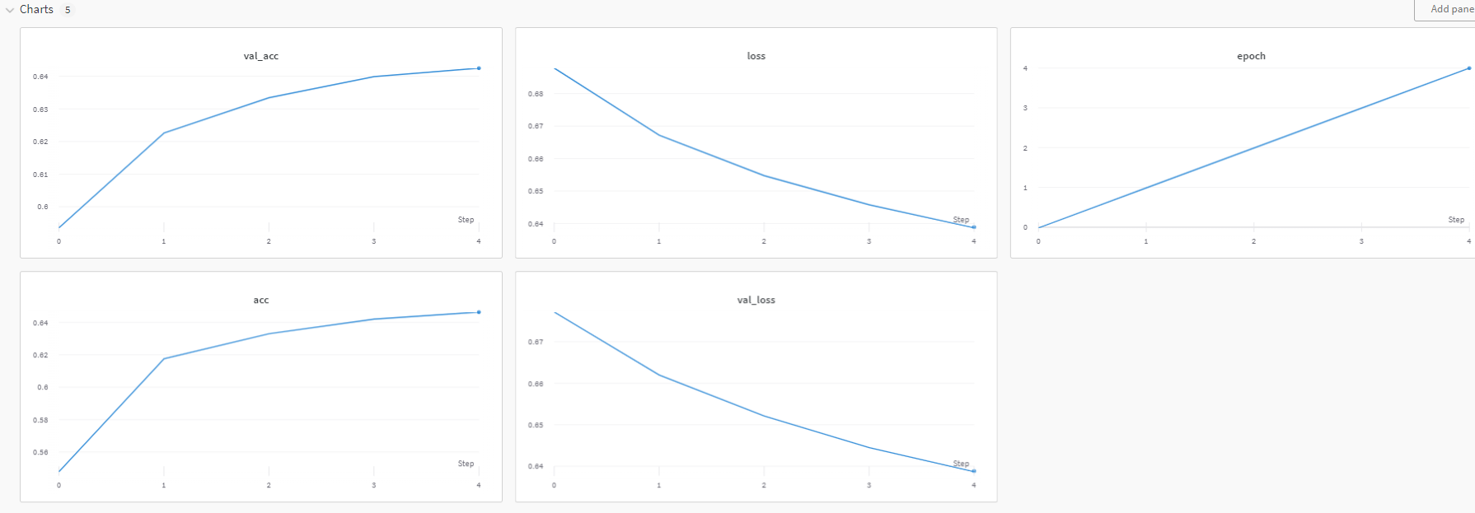
Wandb Results Summary of CNN Model (5 Epochs)

Slide 11
BERT model
The model is fine tuned on on the fake news data
Three linear relu layers are added to the pre-trained bert-base-uncased model as, to perform a specific downstream task like binary classification, addition of a new classifier layer to the pre-trained BERT model is necessary.
Input length = 500
This model gave us an accuracy of 80% on the test data.

Slide 12
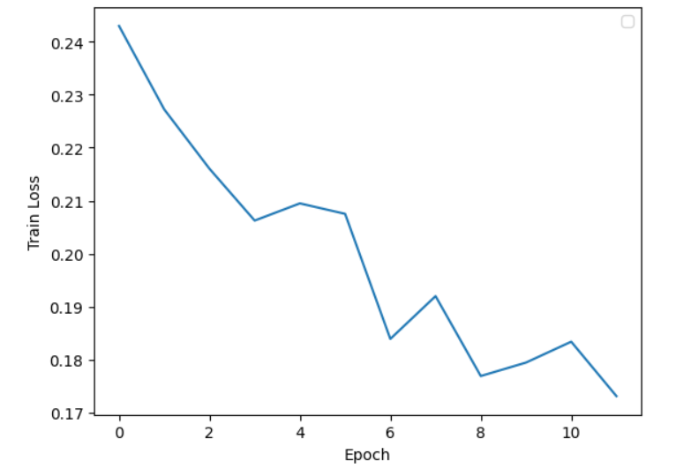
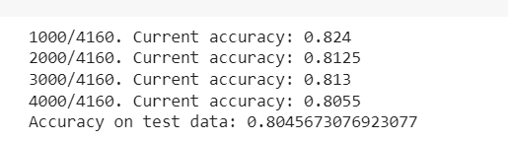
Result Analysis - BERT Model
Interesting observation was that the test accuracy gradually decreased.
Reasons could be - overfitting, catastrophic forgetting or even hyperparameter tuning
But this model performed well on large chunks of news data and classified them accurately

Slide 13
Ensemble Model
An ensemble of 3 models was created namely
Passive Aggressive Classifier
Multinomial Naive Bayes
Random Forest Classifier
VotingClassifier was used to combine the weak and strong learners
Hard Voting approach was used
In hard voting, the final prediction is based on a majority vote of the individual model predictions.

Slide 14
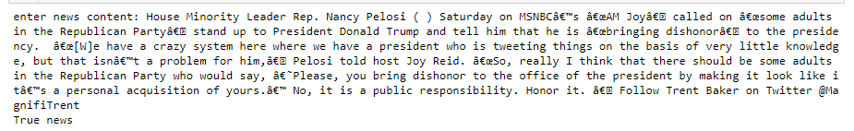
Result Analysis - Ensemble Model
This ensemble gave an accuracy of 90%.
The individual accuracies of PAC, MNB and Random Forest are 96.55%, 77.96% and 85.89%.

Slide 15
Limitations
Fine-tuned BERT Model: Limited data, dataset bias, limited generalization, complexity, and interpretability.
Ensemble Model: Limited improvement if models are too similar, computational expense, and difficulty of deployment.
CNN Model: Sensitivity to hyperparameters, need for large amounts of training data, and limited generalization.

Slide 16
Applications
Election integrity: Fake news detection can help prevent the spread of false information during election cycles, which can impact voter behavior and undermine the democratic process.
Business and finance: Fake news detection can help investors and financial analysts identify false or misleading information that can impact stock prices and other financial metrics.
Media and journalism: Fake news detection can help improve the accuracy and credibility of news reporting, which is especially important in today's highly polarized political climate.
Public safety and health: Fake news detection can help prevent the spread of false information that can have negative impacts on public safety and health, such as misinformation about medical treatments or public safety alerts.

Slide 17
Future Scope
Adversarial attacks: Adversarial attacks are a type of manipulation in which an attacker deliberately introduces subtle changes to a piece of content in order to fool a machine learning model. Future research could focus on developing fake news detection models that are more robust to adversarial attacks.
Context-awareness: Fake news can be highly context-dependent, and the same piece of content may be considered fake news in one context but not in another. Future research could explore ways to develop context-aware fake news detection models that can take into account factors such as the source of the content, the language used, and the social and political climate in which it is shared.
Multi-modal detection: Currently, most fake news detection models focus on analyzing text-based data. However, fake news can also be spread through images, videos, and other forms of media. Future research could explore ways to incorporate multi-modal data sources into fake news detection models to improve their accuracy.

Slide 18
Thank You!

